Slide 1
Communication with I/O Devices && Files and Directories

Slide 2
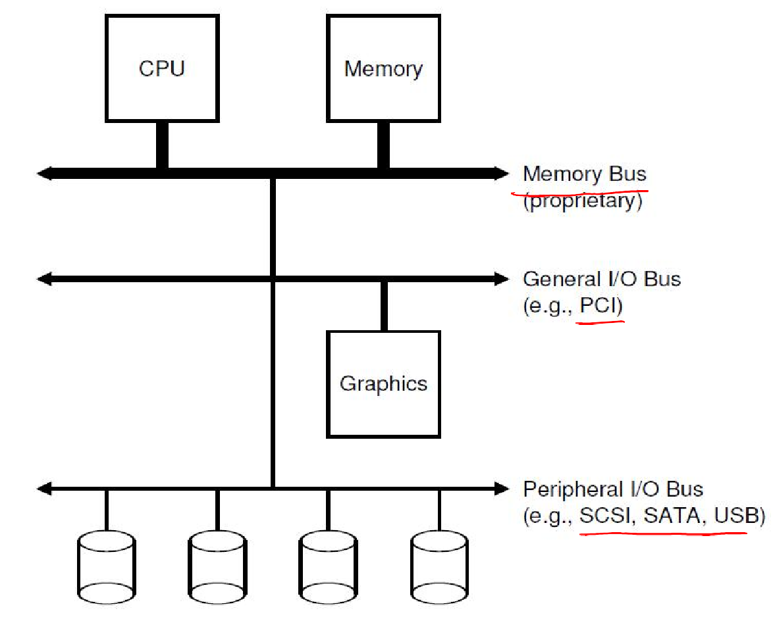
Input/Output Devices
I/O devices connect to the CPU and memory via a bus
High speed bus, e.g., PCI
Other: SCSI, USB, SATA
Point of connection to the system: port

Slide 3
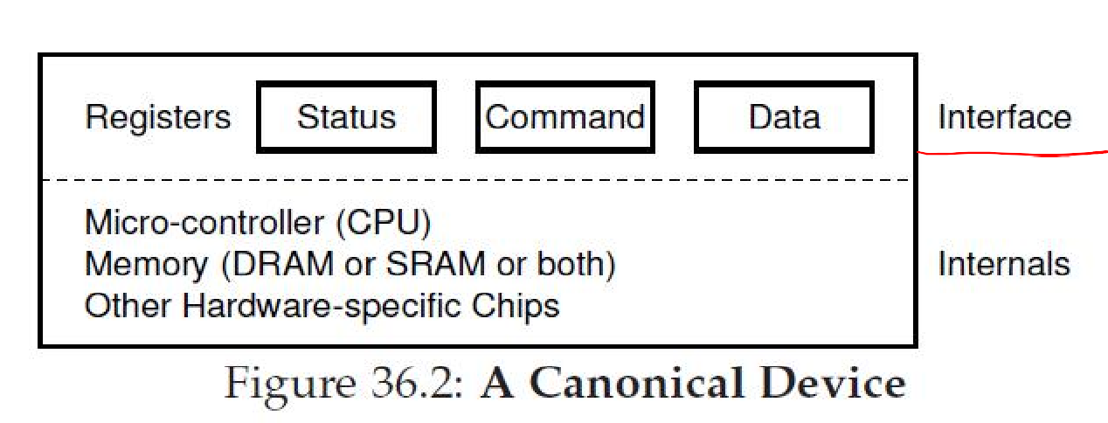
Simple Device Model
Block devices store a set of numbered blocks (disks)
Character devices produce/consume stream of bytes (keyboard)
Devices expose an interface of memory registers
Current status of device
Command to execute
Data to transfer
The internals of device are usually hidden

Slide 4
How does OS read/write to registers?
How does OS read/write to registers like status and command?
Explicit I/O instructions
E.g., on x86, in and out instructions can be used to read and write to specific registers on a device
Privileged instructions accessed by OS
Memory mapped I/O
Device makes registers appear like memory locations
OS simply reads and writes from memory
Memory hardware routes accesses to these special memory addresses to devices

Slide 5
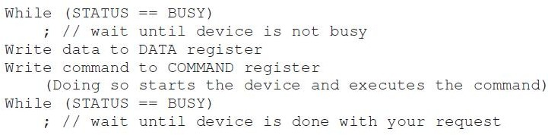
A simple execution of I/O requests
Polling status to see if device ready – wastes CPU cycles
Programmed I/O – CPU explicitly copies data to/from device

Slide 6
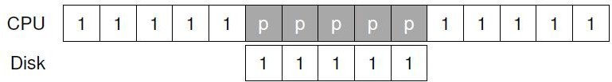
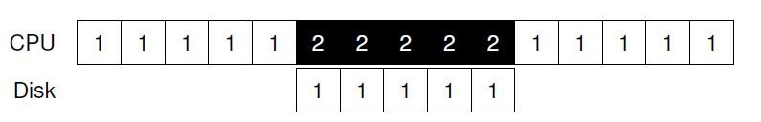
Interrupts
Polling wastes CPU cycles
Instead, OS can put process to sleep and switch to another process
When I/O request completes, device raises interrupt

Slide 7
Interrupt handler
Interrupt switches process to kernel mode
Interrupt Descriptor Table (IDT) stores pointers to interrupt handlers (interrupt service routines)
Interrupt (IRQ) number identifies the interrupt handler to run for a device
Interrupt handler acts upon device notification, unblocks the process waiting for I/O (if any), and starts next I/O request (if any pending)
Handling interrupts imposes kernel mode transition overheads
Note: polling may be faster than interrupts if device is fast

Slide 8
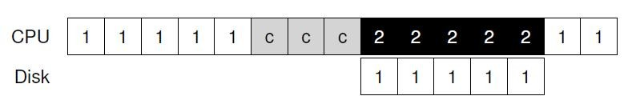
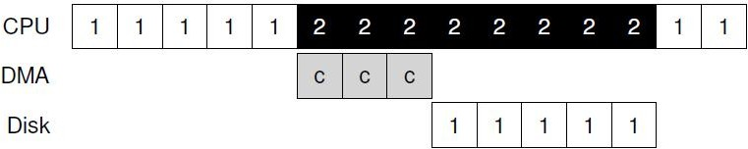
Direct Memory Access (DMA)
CPU cycles wasted in copying data to/from device
Instead, a special piece of hardware (DMA engine) copies from main memory to device
CPU gives DMA engine the memory location of data
In case of read, interrupt raised after DMA completes
In case of write, disk starts writing after DMA completes

Slide 9
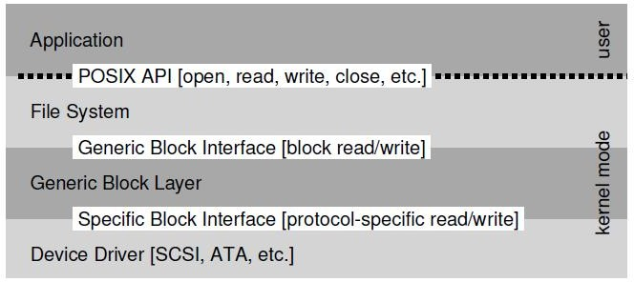
Device Driver
Device driver: part of OS code that talks to specific device, gives commands, handles interrupts etc.
Most OS code abstracts the device details
– E.g., file system code is written on top of a generic block interface

Slide 10
The file abstraction
File – linear array of bytes, stored persistently
Identified with file name (human readable) and a OS-level identifier (“inode number”)
Inode number unique within a file system
Directory contains other subdirectories and files, along with their inode numbers
Stored like a file, whose contents are filename-to- inode mappings

Slide 11

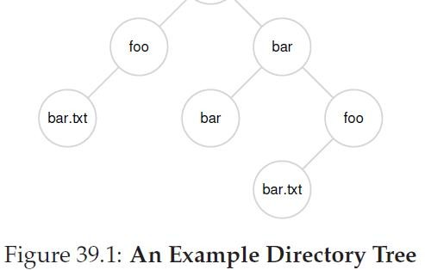
Directory tree
Files and directories arranged in a tree, starting with root (“/”)

Slide 12
Operations on files (1)
Creating a file
open() system call with flag to create
Returns a number called “file descriptor”
Opening a file
Existing files must be opened before they can be read/written
Also uses open system call, and returns fd
All other operations on files use the file descriptor
close() system call closes the file

Slide 13
Operations on files (2)
Reading/writing files: read()/write() system calls
Arguments: file descriptor, buffer with data, size
Reading and writing happens sequentially by default
Successive read/write calls fetch from current offset
What if you want to read/write at random location
lseek() system call lets you seek to random offset
Writes are buffered in memory temporarily, so
fsync() system call flushes all writes to disk
Other operations: rename file, delete (unlink) file, get statistics of a file

Slide 14
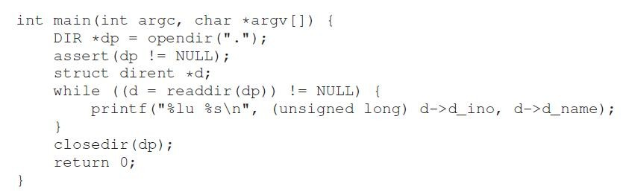
Operations on directories
Directories can also be accessed like files
Operations like create, open, read, close
For example, the “ls” program opens and reads all directory entries
Directory entry contains file name, inode number, type of file (file/directory) etc.

Slide 15
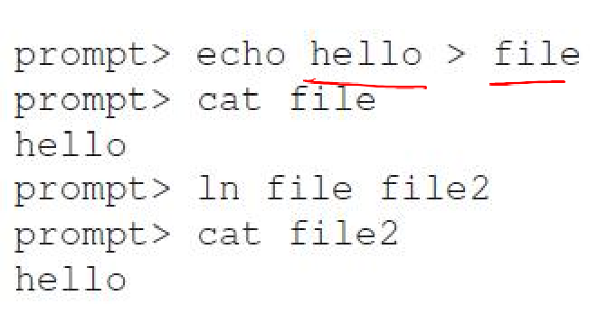
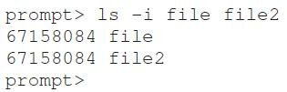
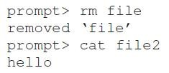
Hard links
Hard linking creates another file that points to the same inode number (and hence, same underlying data)
If one file deleted, file data can be accessed through the other links
Inode maintains a link count, file data deleted only when no further links to it
You can only unlink, OS decides when to delete

Slide 16
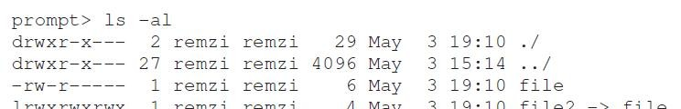
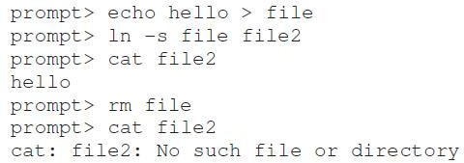
Soft links or symbolic links
Soft link is a file that simply stores a pointer to another filename
If the main file is deleted, then the link points to an invalid entry: dangling reference

Slide 17
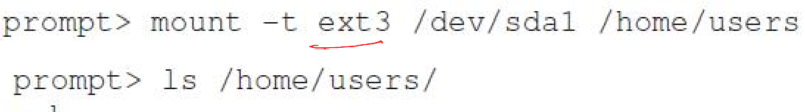
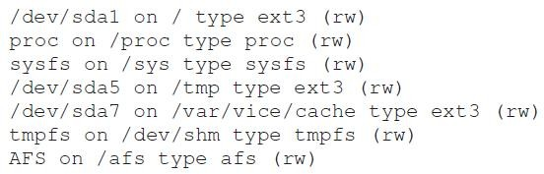
Mounting a filesystem
Mounting a filesystem connects the files to a specific point in the directory tree
Several devices and file systems are mounted on a typical machine, accessed with mount command

Slide 18
Memory mapping a file
Alternate way of accessing a file, instead of using file descriptors and read/write syscalls
mmap() allocates a page in the virtual address space of a process
“Anonymous” page: used to store program data
File-backed page: contains data of file (filename provided as arg to mmap)
When file is mmaped, file data copied into one or more pages in memory, can be accessed like any other memory location in program

